Slide 1
Feature Selection, Dimensionality Reduction Dr. Lov Kumar Assistant Professor, BITS Pilani, Hyderabad Campus

Slide 2
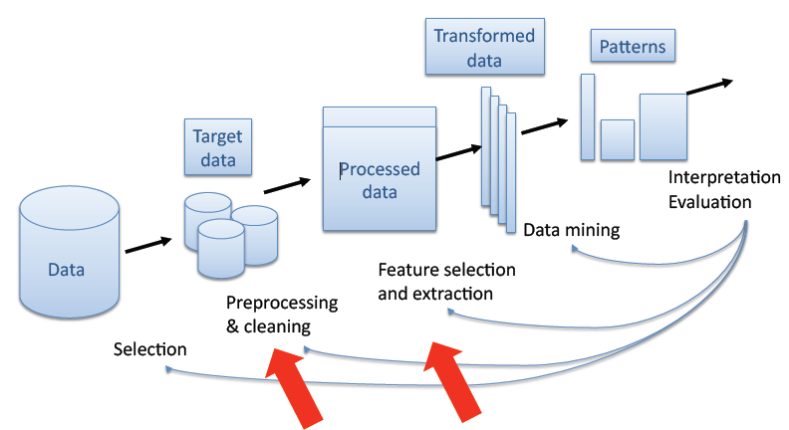
Feature Selection, Dimensionality Reduction

Slide 3
In the presence of millions of features/attributes/inputs/variables, select the most relevant ones.
m features
X
m’
n

Slide 4
Why we need FS:
to improve performance (in terms of speed, predictive power, simplicity of the model).
to visualize the data for model selection.
To reduce dimensionality and remove noise.
Feature Selection is a process that chooses an optimal subset of features according to a certain criterion.

Slide 5
Reasons for performing FS may include:
removing irrelevant data.
increasing predictive accuracy of learned models.
improving learning efficiency, such as reducing storage requirements and computational cost.
reducing the complexity of the resulting model description, improving the understanding of the data and the model.

Slide 6
Steps
searching for the best subset of features.
criteria for evaluating different subsets.
principle for selecting, adding, removing or changing new features during the search.

Slide 7
Feature selection methods can be broadly classified into two subclasses:
Feature ranking methods: In Feature ranking method, some decisive factors have been considered to rank each individual feature and then some of these features are selected which are suitable for a given project.
Feature subset selection method: In feature subset selection, subset of features are searched which collectively have good predictive capability.

Slide 8
Feature ranking methods:
Feature ranking methods rank features independently without using any learning algorithm.
In feature ranking methods, ranking of features are based on the score of the features.
Further top ⌈ log2 n⌉ metrics out of “n” number of metrics have been considered to develop a model.
Example
p( j | t) is the relative frequency of class j at node t

Slide 9
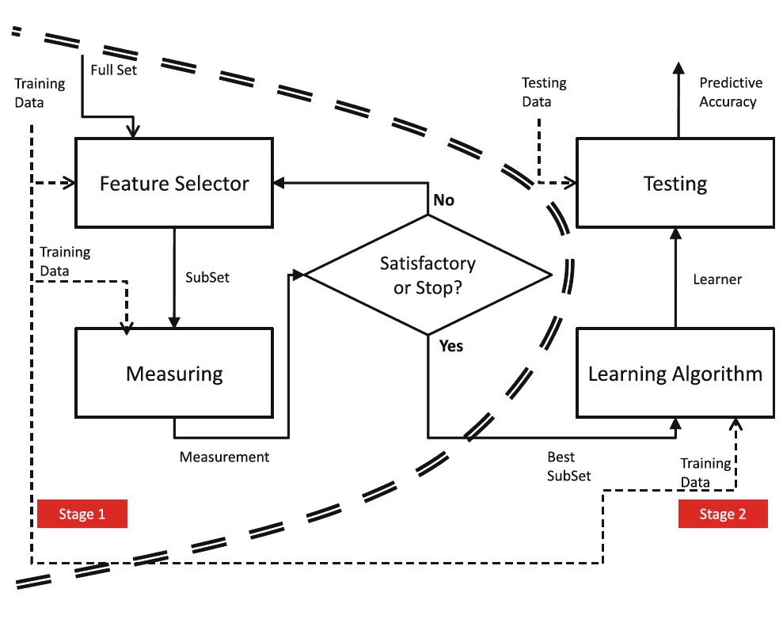
Filters:

Slide 10
Feature-subset selection methods are used to find suitable subset of features which collectively have good predictive capability.
FS can be considered as a search problem, where each state of the search space corresponds to a concrete subset of features selected.
The selection can be represented as a binary array, with each element corresponding to the value 1, if the feature is currently selected by the algorithm and 0, if it does not occur.

Slide 11
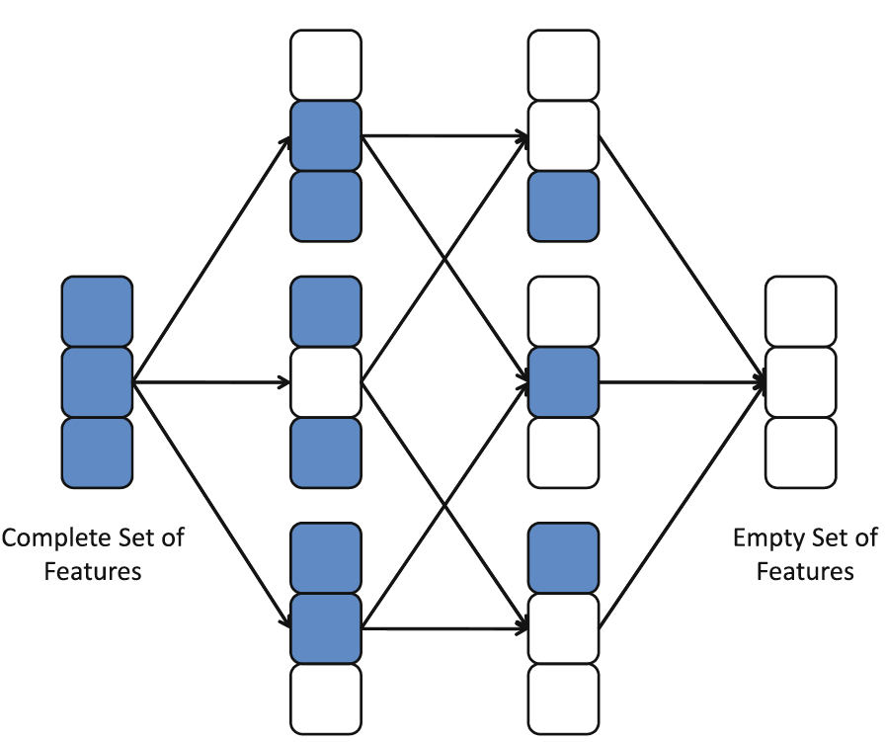

Slide 12
Search Directions:
Sequential Forward Generation (SFG): It starts with an empty set of features S. As the search starts, features are added into S according to some criterion that distinguish the best feature from the others. S grows until it reaches a full set of original features. The stopping criteria can be a threshold for the number of relevant features m or simply the generation of all possible subsets in brute force mode.
Sequential Backward Generation (SBG): It starts with a full set of features and, iteratively, they are removed one at a time. Here, the criterion must point out the worst or least important feature. By the end, the subset is only composed of a unique feature, which is considered to be the most informative of the whole set. As in the previous case, different stopping criteria can be used.

Slide 13
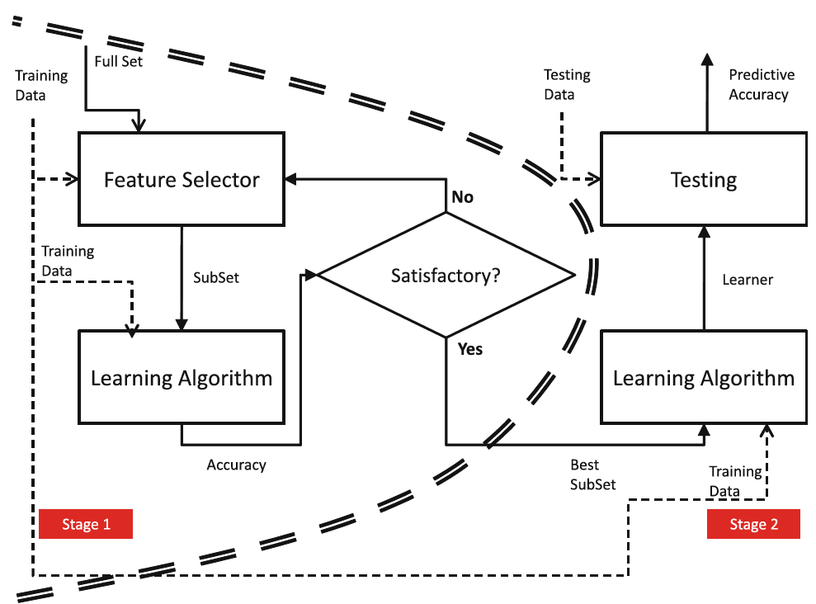
Wrappers

Slide 14
Evaluation
Accuracy
Complexity
Number of Features Selected
Speed of the FS method
Generality of the features selected

Slide 15
Principal Component Analysis (PCA)
Attribute reduction using Principal Component analysis (PCA) is achieved by transforming high dimension data space into lower dimension data space.
takes a data matrix of n objects by p variables, which may be correlated, and summarizes it by uncorrelated axes (principal components or principal axes) that are linear combinations of the original p variables

Slide 16
Procedures of PCA
1st Step: Pre-treatment of Data Matrix→Scaling
2nd Step: Calculation of covariance matrix
3rd Step: Calculation of eigenvalues and eigenvectors of covariance matrix
4th Step: Calculation of scores

Slide 17
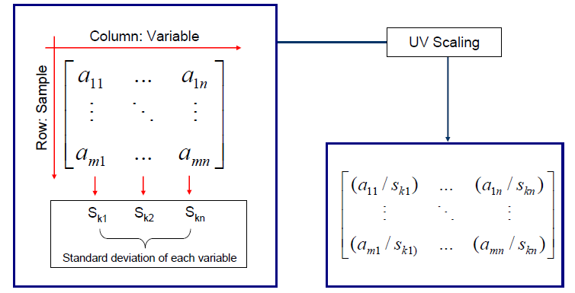
1st Step: Pre-treatment of Data Matrix→Scaling
Pre-treatment of Data Matrix-Scaling
Unless the data are normalized, a variable with a large variance will dominate
Most common scaling technique – Unit variance (UV) scaling

Slide 18
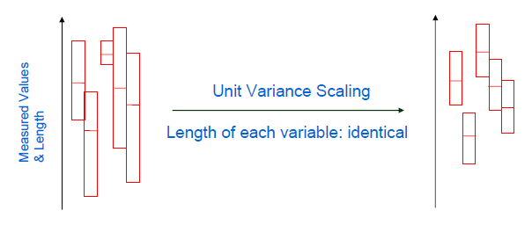
Note: However, the mean values still remain different
Therefore mean-centering as a second part of pre-data processing
Step1) Average value of each variable is calculated
Step2) Subtracted from the data

Slide 19
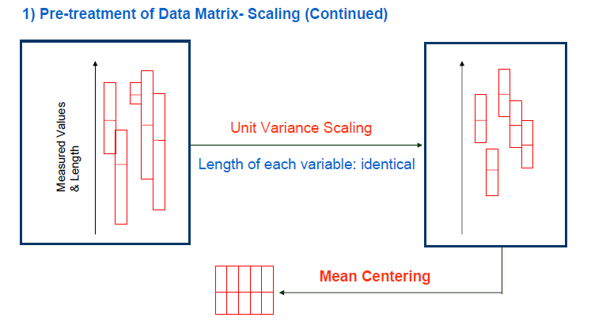

Slide 20
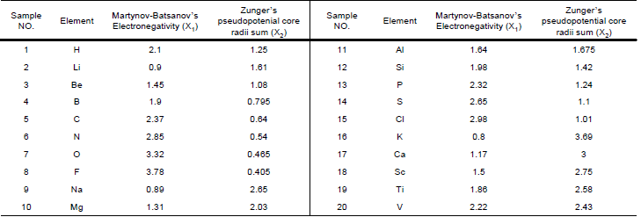
Example of Data Matrix: X

Slide 21
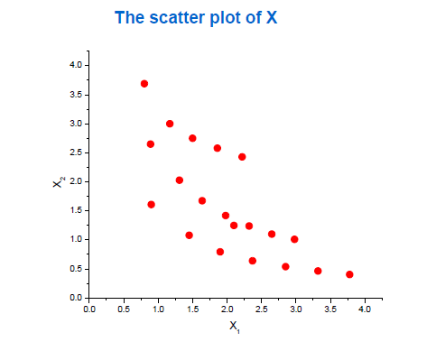
Example of Data Matrix: X (continued)

Slide 22
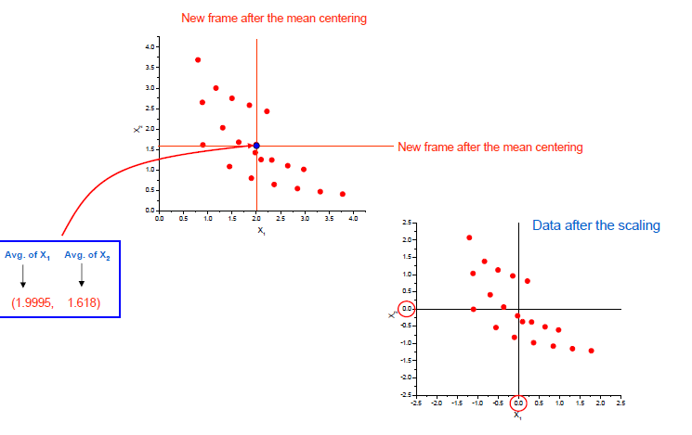

Slide 23

2nd Step: Calculation of covariance matrix
Calculation of Covariance matrix(S) of Data Matrix(X)
Variance (1 dimensional concept): Measure of the spread of data in a given data set
Covariance (Multi-dimensional concept): Measure of the spread of data between dimensions (variables)

Slide 24
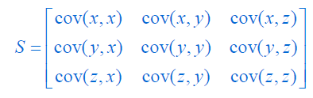
Calculation of Covariance matrix(S) of Data Matrix(X):

Slide 25
3rd Step of PCA: Calculation of eigenvalues and eigenvectors of covariance matrix
1) Calculation of Eigenvalues of Covariance matrix (S)
2) Calculation of the corresponding Eigenvectors of Covariance matrix (S)

Slide 26
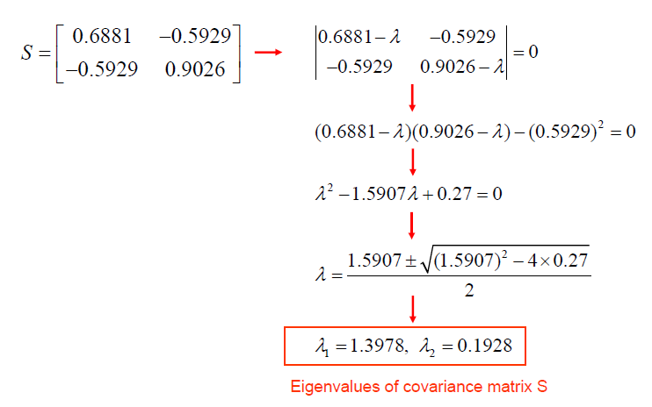

Slide 27
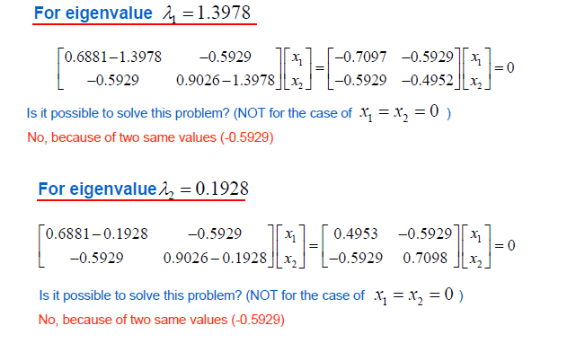
The command is [P, ∧]=eig(S). Then you will get followings in Matlab.

Slide 28
Total eigenvalues will be 0.1928+1.3978=1.5906 and this is the same as total variance
Eigenvalues represent the lengths of the two principal axes of ellipse. Therefore the axes represent the total variance of the data set.
The first principal axis contains 1.3978/1.5906=87.88% of the total variance.
Second principal axis represents 0.1928/1.5906=12.12% of the total variance.

Slide 29
4th Step of PCA: Calculation of scores
PC1 =α1X1 +α2X2
PC2 = β1 X1 +β2 X2
α ’s are the elements of the first eigenvector
β ’s are the elements of the second eigenvector
Or
PCA=Data*Eigenvector

Slide 30
